Slide 1
Build Your Marketing Plan
A ResQRoof Learning Lab Tool
Notes:
I chose this template as it is a clean template with a calming color scheme

Slide 2
Welcome to Part 1 of our Marketing Series
Are you:
a business owner who would like to create or understand how to effectively market your business?
a business owner who would like to see their customer base grow?
a business owner with a desire to learn higher engagement techniques with potential customers?
a member of the ResQRoof Cooperative?
Notes:
This will be a three part series for marketing a business.

Slide 3
Do You Have What It Takes To Build A Marketing Plan?
You will need:
A computer
Internet access
The ability to navigate the internet
A desire to learn
About three hours of your time
Notes:
The learner will take this tutorial from their own home or office computer. It is an online tutorial.

Slide 4
Upon successful completion of this tutorial, the learner will be able to:
Understand and explain
Understand and explain awareness and engagement criteria for marketing effectiveness.
Identify
Identify target audience (customer)
Identify
Identify business brand
Write
Write a marketing strategy
Identify
Identify types of content and know what is effective for your business

Slide 5
This is our plan for Part 1 of our Marketing Plan Series:
Learning Outcomes
Awareness & Engagement
Target Audience
Business Branding
Strategize
Create Content
Priorities
Process
Identify Demo-graphics
Who Are You
Understand Strategy
Types of Content
Four Priorities
Website
Increase Customer Base
What Do You Want
Benefits of a Strategy
Four Standards of Content Development
Assessment
Social Media
Assessment
Why
What
Assessment
Activity
Local Advertising
Assessment
Part 2
Notes:
I am leaving blank spaces for future inspirations or thoughts. This flowchart is subject to change.

Slide 6
Today’s Agenda
Understanding Awareness and Engagement Criteria (40 minutes)
Identifying Your Target Audience (40 minutes)
Business Branding (30 minutes)
What Is A Strategy? (30 minutes)
Content (30 minutes)
Notes:
Just a brief agenda. Upon completion, I will create an exact timeline that should reflect an accurate pace.

Slide 7
Awareness and Engagement Criteria
You will learn how to: Build Awareness and Effectively Engage Customers
Let’s test your knowledge about Awareness

Slide 8
What is Brand Awareness?
Brand awareness is the degree to which consumers are familiar with your brand, including its distinctive qualities and features, as well as the products of services you offer.
True
False

Slide 9
Correct
Continue tutorial

Slide 10
Oops, try again.
Go back

Slide 11
Brand Awareness is a single focus
True
False

Slide 12
Correct
Continue tutorial

Slide 13
Oops, try again.
Go back

Slide 14
There are many elements involved in the improvement of your brand awareness. One choice below is NOT an element. Which choice?
Building customer awareness
Developing your website
Promoting your website
Adding value to your industry
Promoting your social media profile

Slide 15
Correct
Continue tutorial

Slide 16
Oops, try again.
Go back

Slide 17
How to Build Awareness With: your brand, your customer, your advertising options This will be a focus in today’s tutorial.
Focus on specific target audiences
Use search engine optimization
Prioritize customer engagement
Review and revise marketing plans
Target your customer base on a broader scale
Create outstanding content
Utilize other brands to partner for customers (RQR)
Each of the above topics contain a link for additional information.

Slide 18
Engagement With Your Customer Base
Priorities
What is your #1 Priority as a business owner?
If you said customer experience is your top priority, excellent. You are in business and the customer keeps you in business.
Notes:
Theme will be consistent with Priority numbers. Still playing around with the layout and color scheme.

Slide 19
Excellent Examples of #1 Priority: Customer Experience
Successful customer service experiences in two top companies
Amazon:
Two day free delivery with membership
Front door service with their own vans
Employing local delivery personnel 24/7
Free return shipping
Recently, one day delivery
Starbucks:
Very active on social media and posts selfies of customers drinking Starbucks
Made the consumer “their brand”
Locations use specific plants, smells, sounds, colors and lighting to make the customer experience aesthetically pleasing
Notes:
This slide is pretty much finished. I believe all learners can relate to Amazon and Starbucks so I feel these are two well known examples that are relevant to the learner.

Slide 20
#2 Priority: Humanize Your Brand
How has Starbucks and Amazon humanized their brand?
How do you engage your customers?
Notes:
This slide may be changed to demonstrate a consistency in the Priority titles. Have not decided on the look. If you have an opinion, please share.

Slide 21
Take a moment to list the ways in which you:
Make each customer a priority whether or not they are a current or potential customer.
Humanize your brand to ensure your customer can relate.
Click below to document your customer experience.
Notes:
I was looking for a bold icon to get the reader’s attention as this is a task. I believe it may be too bold though.

Slide 22
#3 Priority: Personalize Customer Communication
1. How do you communicate with your customer?
2. Do you respond immediately when a customer reaches out to you?
3. Do you listen to the customer and value what they say?
Notes:
A fourth way of presenting a Priority page.

Slide 23
Create a personalized experience for your customers
How have Starbucks and Amazon created a personalized customer experience?
Personalized communication is important.
Do you respond to emails or phone calls quickly?
Do you offer a digital means for customers to communicate?
Ideas for connecting with customers:
Do you know their birthdays? You can send them a card and ask how their product is faring each year on their birthday. Doctor offices often send out birthday wishes.
Add personalization to your website such as surveys or other communication.
Create a blog page where you can interact with the customer.

Slide 24
Listen
Customers always have an opinion. Demonstrate that you take this opinion seriously. What greater way to build your customer base then by making this personal and gaining brand respect through word of mouth.
Remain active with your social media accounts. Review your profile, read responses from followers, use analytics to measure responses and let your followers and customers know that they have been heard.

Slide 25
#4 Priority: Use Social Media
Do you use any form of social media?
If so, do you post or repost customer comments, experiences etc? This is a great way to humanize your site.
Notes:
Again, a third type of Priority presentation. Please give an opinion on which you prefer, or if a variety is a preference.

Slide 26
In the roofing industry, some of your customers will be digital natives. If you have not already, think about making the transition to social media to connect with your customer.
Customers do their research. They look for websites, online reviews and ask others about their experiences with companies. You must have a positive presence.
We will learn more about this in a short time, when we discuss Process
Notes:
Plain. I need to remove the red arrow from the template pages on most of these, and this page is still a work in progress.

Slide 27
Process
The process by which we fulfill the priorities is three fold and each is very important.
First and foremost, do you have a website presence?
Notes:
Simple introduction to a new focus now that we have completed the four priorities.

Slide 28
Website
Open up another internet tab and take a few minutes to do a search for your business name.
Where is it listed?
Compile a list.
It will help you understand the overall coverage your site is garnishing and assess any changes you feel will impact visibility.

Slide 29
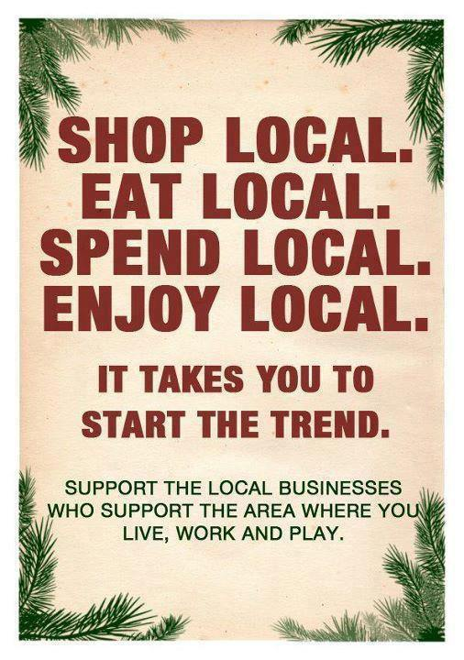
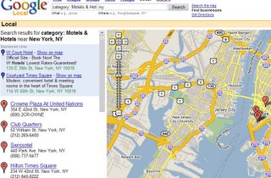
Local Advertising
Don’t forget this offline medium. Many customers now search the internet for their business needs, but as a local contractor, there remains a high importance for local advertising.
Notes:
Let me know if you want clip art images included.

Slide 30
Social Media
There are TWO main reasons you should be using social media:
Volume: Through social media, you can heighten the awareness of your business to tens of thousands of people for practically no cost.
Connectedness: Social media is about relationships. What better way to connect with an audience?
Does the mention of social media create enthusiasm or anxiety? Social media can be very effective and time consuming.

Slide 31
Types of Social Media
Facebook
Twitter
Instagram
Pinterest
LinkedIn
There are many other types of social media, but these are the five largest formats with the highest membership.
This is not a social media tutorial, but include social media in your marketing plan. Take the assessment on the next slide to determine which social media format is best for your business.

Slide 32
Set up a website or blog for your business
Use LinkedIn as one of your primary platforms
Use Facebook as a platform
Consider using Twitter
No
Other businesses
Do you have a website or blog?
Is your target market end consumers or other businesses?
Do you have a storefront or physical business that customers visit?
No
Do you sell a physical that you can show pictures?
No
End Consumers
Yes
Yes
Yes
Consider using Twitter
Use Google as a platform
Add Pinterest as a primary platform
Click here to test your social media savvy
Notes:
This is a flow chart for social media choices. I have been playing around with a vertical vs. horizontal presentation.

Slide 33
We have covered a lot. Let’s review:

Slide 34
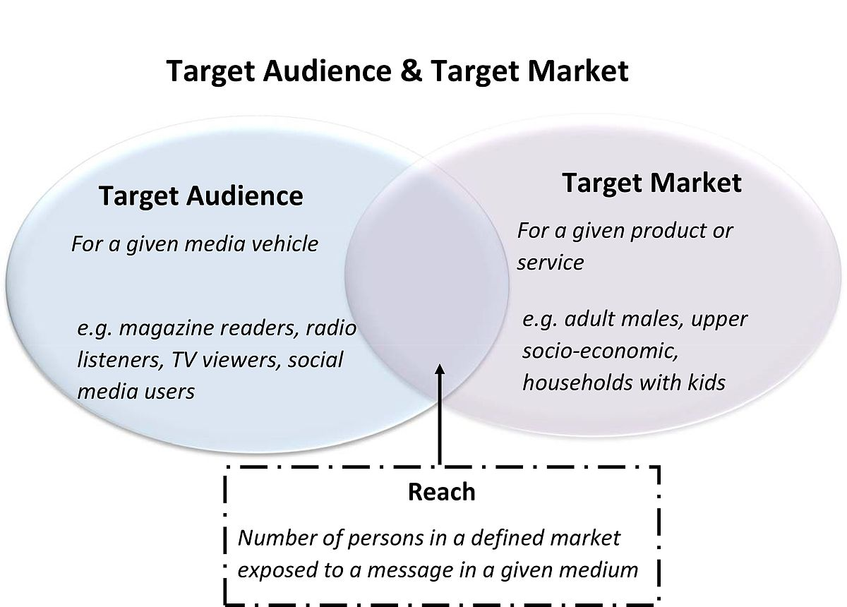
Target Audience
Who is your typical customer?
Who would purchase my product or service?
How do I find out?
What features does my product or service offer?
Do they benefit from this feature?

Slide 35
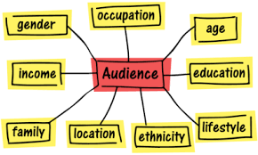
This is an activity that will help you determine your target audience:
Click the button to the right. This will take you to an activity that will guide you through determining your target audience
Notes:
Is the black too bold? The “Click Here” link will be a live link to a website where the learner may complete the task. The website has not yet been created.

Slide 36
Business Branding
You have already mastered the first step by identifying your target audience. Great job.
Now let’s look at your business and why you began this business.
Notes:
It is assumed that successful cooperative partners will have a successful branding, so this is designed an just an enlightenment rather than a learning experience. Feedback can determine if the partner would like a complete tutorial on Branding.

Slide 37
Follow this link to take you to your next activity:
Notes:
This will take the learner to a web page that will ask them Who they are (as a business) and review many characteristics and criteria to stimulate the thought process of business branding.

Slide 38
Strategize Importance of a strategy: create a plan and eliminate chaos
Promotional and marketing strategies are determined in the initial phases of developing a marketing plan, which is a crucial component for any business.
What strategies or ideas do you have for your products?
What is the price points of those products?
How will you distribute your product?
How will your customer know and understand your product?

Slide 39
Importance of Creating a Marketing Strategy
According to Starza Thompson, a marketing strategy is crucial because:
You know your target audience and customers.
You know your business and the benefits for others.
It provides a guide for your marketing plan and your budget.
You know the look of success.
Remember talking about consistency, communication and value? Your strategy aligns these important factors.
You know how your business stacks up against your competition.
“When you have a marketing strategy in place, you know exactly what you do, who you benefit, how you go to market, and how you can measure success.”

Slide 40
Let’s Create a Strategy Based on What You Have Learned.
Notes:
This link will lead the learner to a page on a website where they will have the opportunity to create their strategy in a step by step process. If they already have a strategy, it may benefit them to complete the activity and compare their creation to their current practices.

Slide 41
Content Marketing

Slide 42
Take a short pre-test to assess your content marketing skills:
Notes:
Again, the link is not live as the website is not created.

Slide 43
Types of Content
Pictures
Infographics
Blogs
Videos
Fact Sheets
Mailers
Promotional Content
Social Media Posts/Blasts
SEO/Google Ads

Slide 44
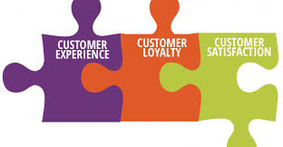
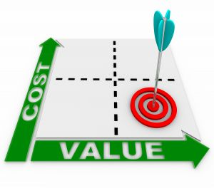
The four standards of promotional content development:
Relevance: your content posted must be relevant to the target audience.
Engagement: your posts must be engaging for your target audience. Ask questions, create a poll or respond to comments.
Value: your readers want value. Will your posting help them?
High Quality: ensure images are clear, no spelling or grammatical errors

Slide 45
On a separate sheet of paper, please list the reason for each standard and an example
Standard | Reason | Example
Relevance
Engagement
Value
High Quality

Slide 46
Click below to list the challenges you have experienced and the successes you can share:

Slide 47
Here is an inspirational infographic to guide you as you begin this process.
https://create.piktochart.com/output/39491171-marketing-strategies

Slide 48
References:
123RF. (n.d.) Retrieved from: https://www.google.com/search?q=business+office+chaos+clipart&rlz=1C1CHBF_enUS809US809&source=lnms&tbm=isch&sa=X&ved=0ahUKEwjkn_Xv1briAhVSKawKHR3zD-cQ_AUIDigB&biw=1260&bih=544#imgrc=ZdTm5tSdVcwDYM:
Ahrefs. (2018). SEO For Beginners: A Basic Search Engine Optimization Tutorial for Higher Google Rankings. Retrieved from: https://www.youtube.com/watch?v=DvwS7cV9GmQ
Author (n.a.) Retrieved from: https://nowhabersham.com/shop/local/important/.
Bronhiggs. (2016). Wikimedia Commons. Retrieved from: https://commons.wikimedia.org/wiki/File:Target_Audience_and_Target_market.jpg
Cereal Entrepreneur: https://www.google.com/search?q=create+outstanding+content&rlz=1C1CHBF_enUS809US809&oq=create+outstanding+content&aqs=chrome..69i57.5363j0j4&sourceid=chrome&ie=UTF-8#kpvalbx=1
Clipart library. (n.d.) Retrieved from: http://clipart-library.com/brand-cliparts.html
Courneya, M. (2018). Retrieved from: https://medium.com/rta902/a-warning-message-to-myself-of-social-media-but-not-really-e6badf700833
Inc.com. (n.d.). Retrieved from: www.inc.com/guides/2010/06/defining_your_target_market.html
Kysa. (n.d.) KissPNG. Retrieved from: https://www.kisspng.com/png-social-media-clip-art-christmas-social-networking-6898596/
Mclellan. M.G. (n.d.). Retrieved from: https://www.mclellanmarketing.com/images/2011/12/bigstock_Cost_Value_Matrix_-_Arrow_And__9732935.jpg
Naylor, T.J. (2014).4 Reasons Good Customer Service is Vital. Business to Community. Retrieved from: https://www.business2community.com/customer-experience/4-reasons-good-customer-service-vital-0934198
Prer, J. (n.d.) Kissclipart. Retrieved from: https://www.kissclipart.com/ask-the-experts-clipart-customer-engagement-brand-u2urem/
Pomerantz. M. (n.d.) Retrieved from: https://www.marypomerantzadvertising.com/blog/reaching-target-audience
Notes:
Complete list of references to date, but not in APA format as of yet.

Slide 49
Priorities clip art. (n.d.). Retrieved from: https://www.gograph.com/vector-clip-art/priorities.html Entrepreneur. (n.d.). Use These 5 Steps To Create A Marketing Plan. Retrieved from: https://www.entrepreneur.com/slideshow/299487#1 SCCPRE. (n.d.). Retrieved from: https://www.sccpre.cat/maxp/iTxRJwJ/ Smithson, (2015). 6 Tips for Reaching a Larger Target Marker. Retrieved from: https://www.brandingmag.com/2015/07/23/6-tips-for-reaching-a-larger-target-market/ Standberry, S. (2018). Content Marketing. LYFE Marketing. Retrieved from: https://www.lyfemarketing.com/blog/types-of-content-marketing/ Thompson, S. (2018). 7 Reasons Why Marketing Strategy is Important for your Business. Women Belong. Retrieved from: https://www.womenbelong.com/7-reasons-why-marketing-strategy-is-important-for-your-business/ Tracy, B. (2017). Retrieved from: : https://www.youtube.com/watch?v=y0OtFpC7yag&t=108s

